Slide 1

Consumer Goods
Function: Executive Management

Slide 2

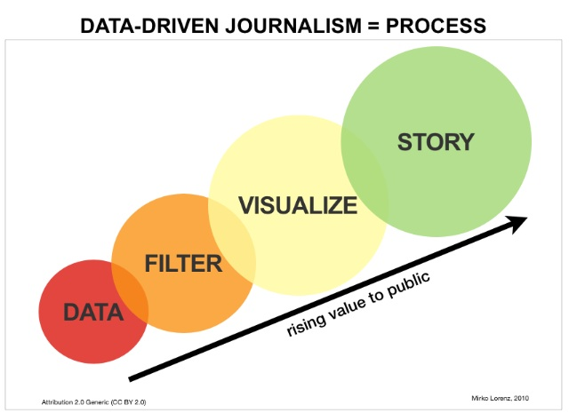
Purpose of Project:
Data-Driven Decision-Making: Empower informed choices through data analytics across all operations.
Sales Enhancement: Boost revenue by identifying profitable areas and optimizing sales strategies.
Cost Reduction & Sales Optimization: Uncover sales patterns and target customer segments for efficiency and profitability. optimize sales and revenue generation.

Slide 3

Business Requirements:
Domain: Consumer Goods | Function: Executive Management
Atliq Hardware (imaginary company) is one of the leading computer hardware producers in India and well expanded in other countries too.
However, the management noticed that they do not get enough insights to make quick and smart data-informed decisions. They want to expand their data analytics team by adding several junior data analysts. Tony Sharma, their data analytics director wanted to hire someone who is good at both tech and soft skills. Hence, he decided to conduct a SQL challenge which will help him understand both the skills.
This Photo by Unknown Author is licensed under CC BY-SA-NC

Slide 4

Scope of the Project:
Data Analysis: Conduct a thorough analysis of historical sales data to identify trends, patterns, and opportunities for improvement.
Customer Segmentation: Define and segment target customer groups based on purchasing behaviour, demographics, and other relevant factors.
Sales Strategy Development: Collaborate with stakeholders to develop data-driven sales strategies and tactics tailored to each customer segment.
Performance Monitoring: Implement performance tracking mechanisms to continuously assess the impact of new strategies and make data-driven adjustments as needed.

Slide 5

Software Requirement
MySQL
Ms Excel
Power BI
Presentation App

Slide 6
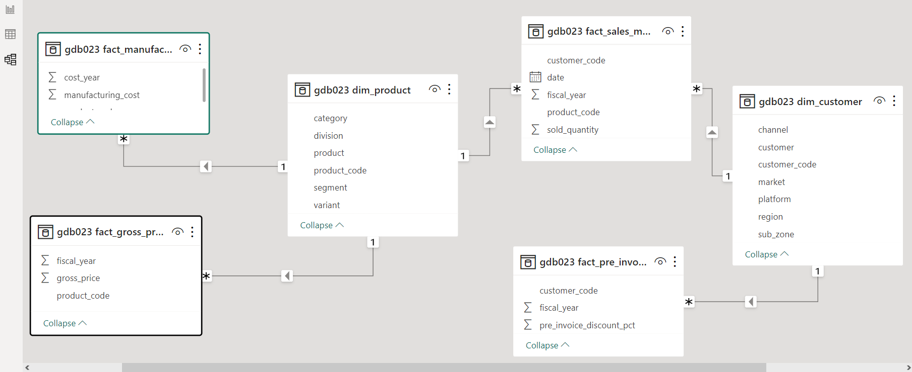
Data Model:

Slide 7
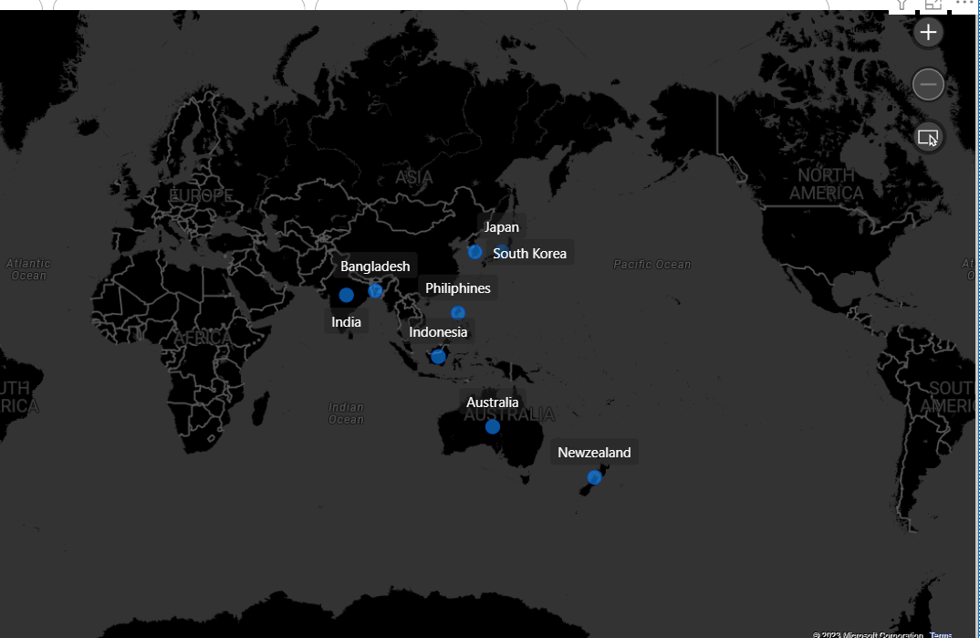
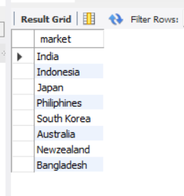
1. Provide the list of markets in which customer "Atliq Exclusive" operates its business in the APAC region.

Slide 8
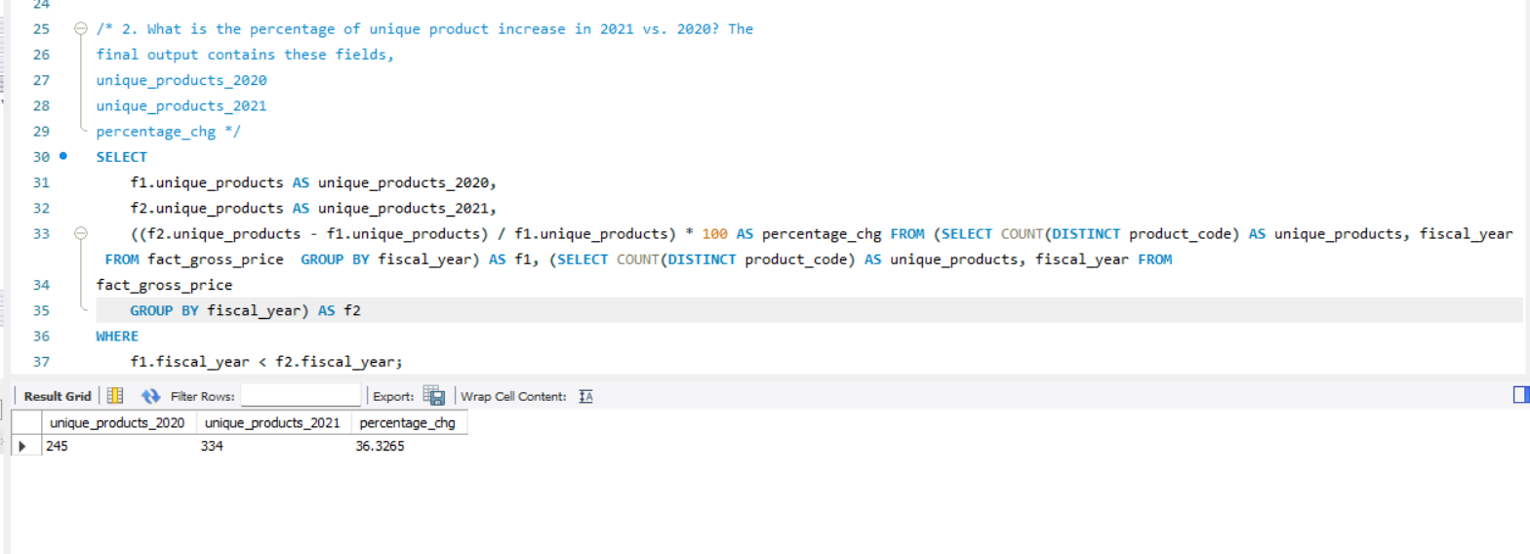
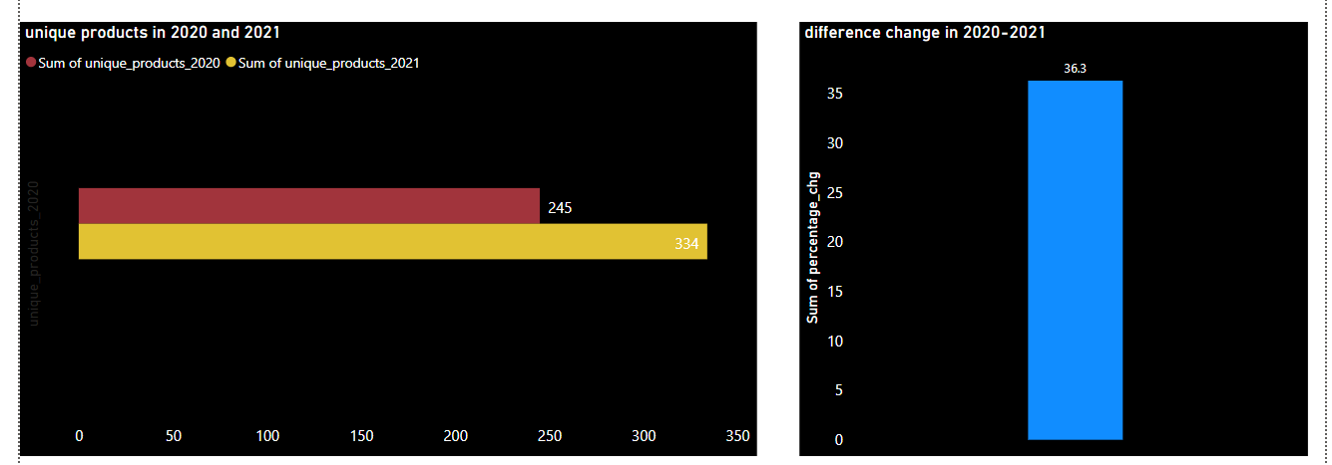
2. What is the percentage of unique product increase in 2021 vs. 2020? The final output contains these fields, unique products 2020 unique products-2021 percentage chg

Slide 9
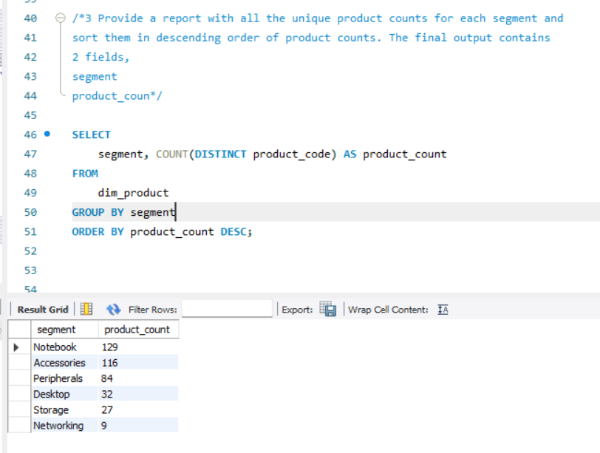
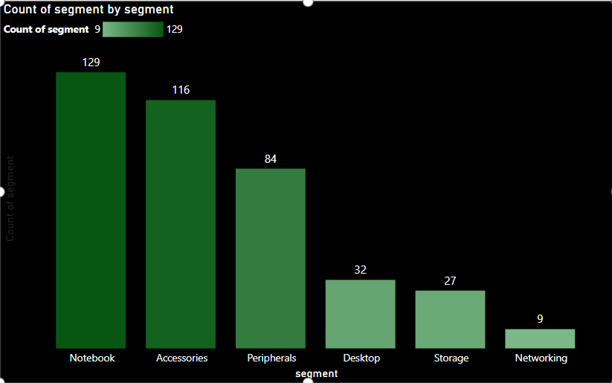
3. Provide a report with all the unique product counts for each segment and sort them in descending order of product counts. The final output contains 2 fields, segment product count

Slide 10
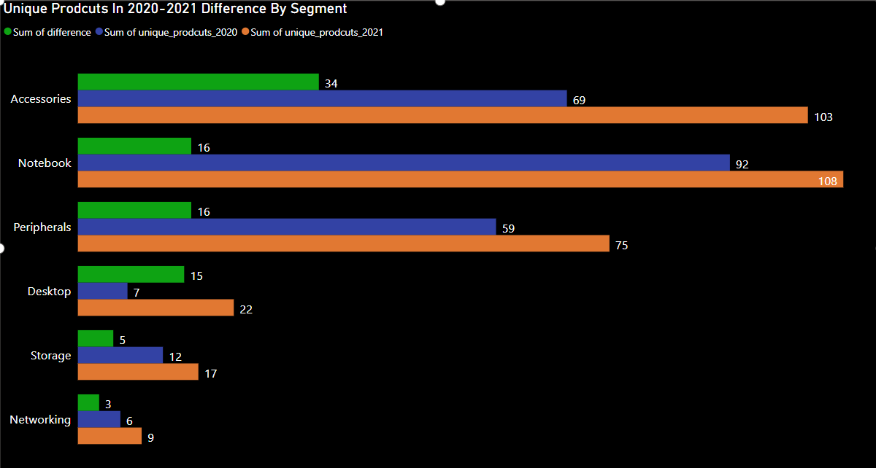
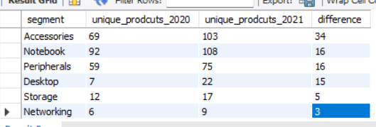
4. Follow-up: Which segment had the most increase in unique products in 2021 vs 2020? The final output contains these fields, segment product count-2020 product count-2021 difference
Insights:
In 2021, the accessories category featured a greater number of unique products compared to 2020.
In contrast, there were fewer unique networking products in 2021 compared to 2020.

Slide 11
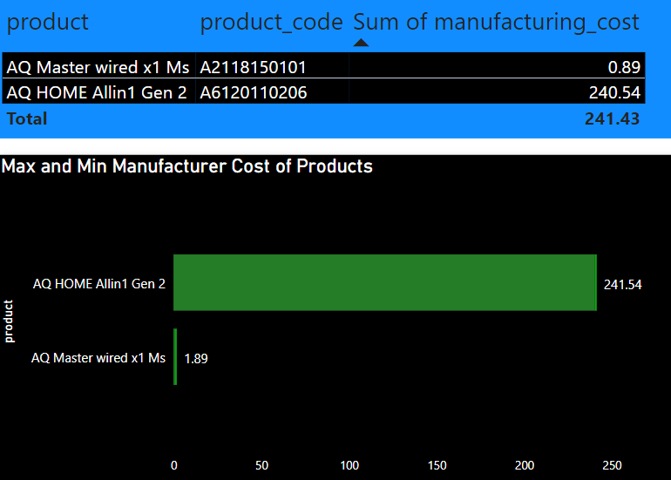
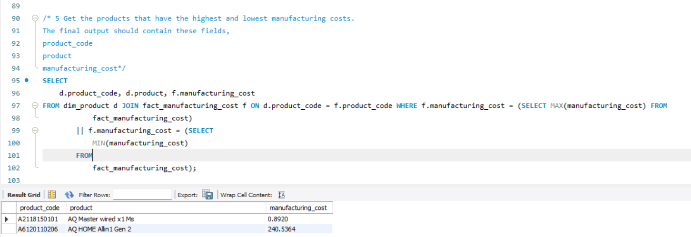
5. Get the products that have the highest and lowest manufacturing costs. The final output should contain these fields, product code product manufacturing cost
Max & Mini:
Product: AQ HOME allin1 Gen 2 = 240.54
Product: AQ Master wired x1 Ms = 0.89

Slide 12
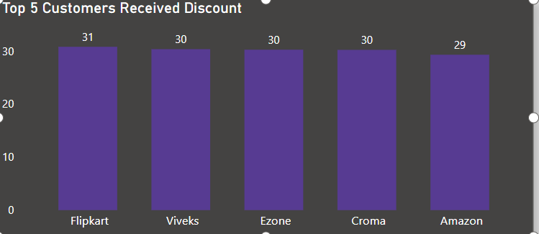
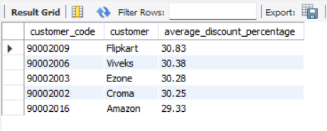
6. Generate a report which contains the top 5 customers who received an average high pre invoice discount pct for the fiscal year 2021 and in the Indian market. The final output contains these fields, customer code customer average discount percentage

Slide 13
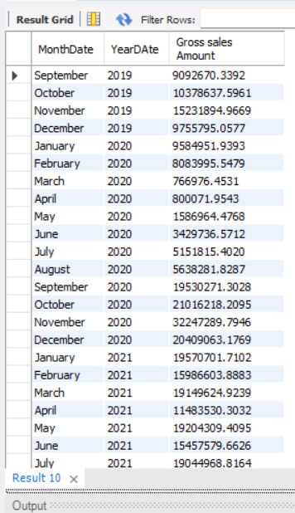
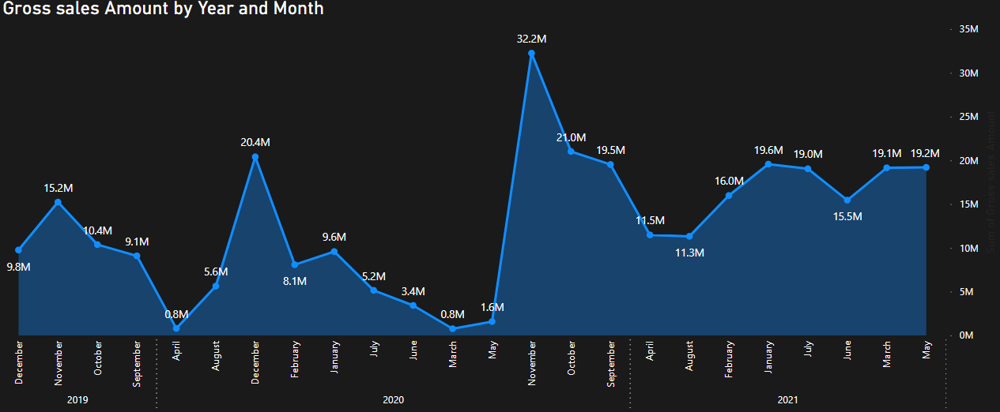
7. Get the complete report of the Gross sales amount for the customer “Atliq Exclusive” for each month. This analysis helps to get an idea of low and high-performing months and take strategic decisions. The final report contains these columns: Month Year Gross sales Amount

Slide 14
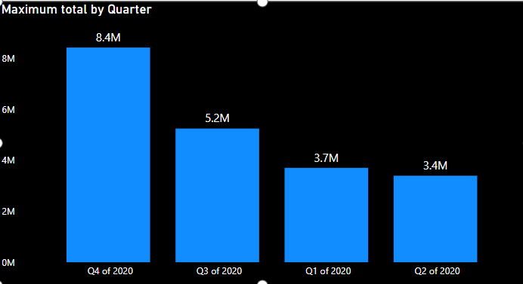
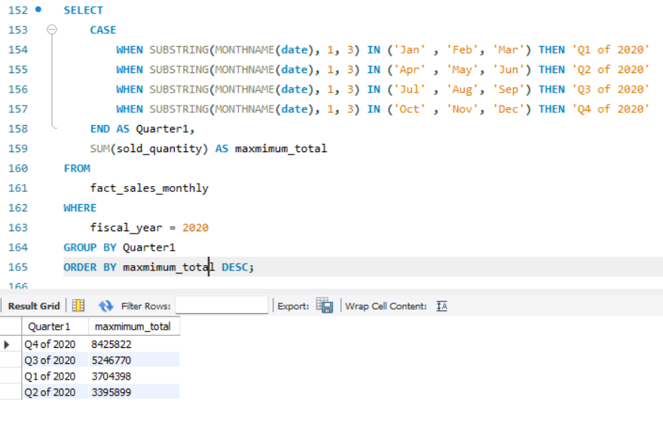
8. In which quarter of 2020, got the maximum total sold quantity? The final output contains these fields sorted by the total sold quantity, Quarter total sold quantity

Slide 15
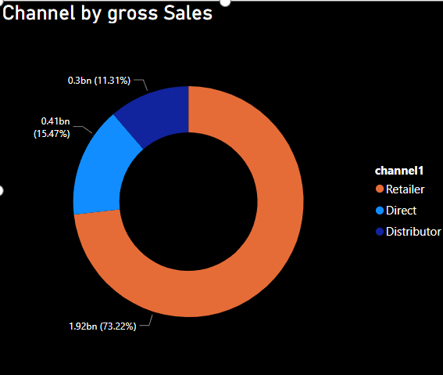
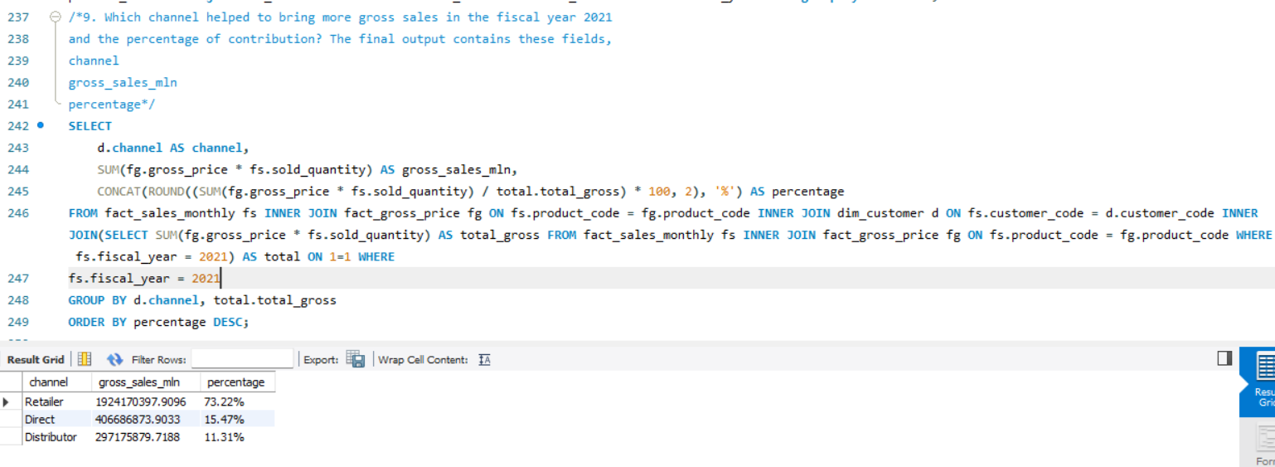
9. Which channel helped to bring more gross sales in the fiscal year 2021 and the percentage of contribution? The final output contains these fields, channel gross sales minepentate

Slide 16
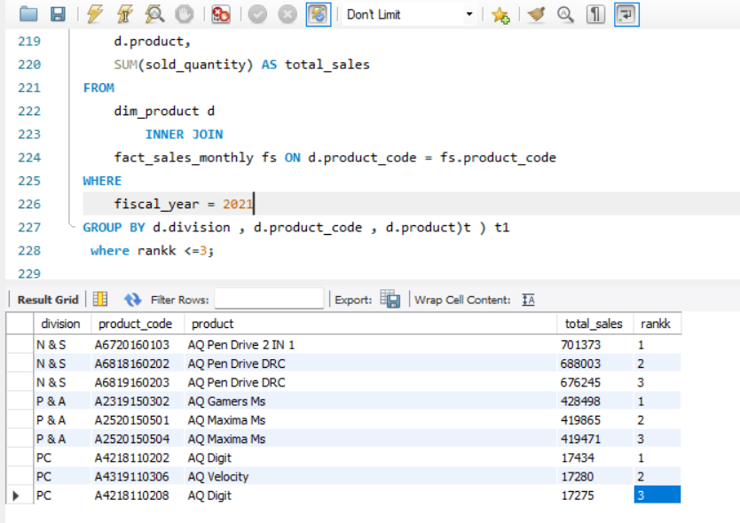
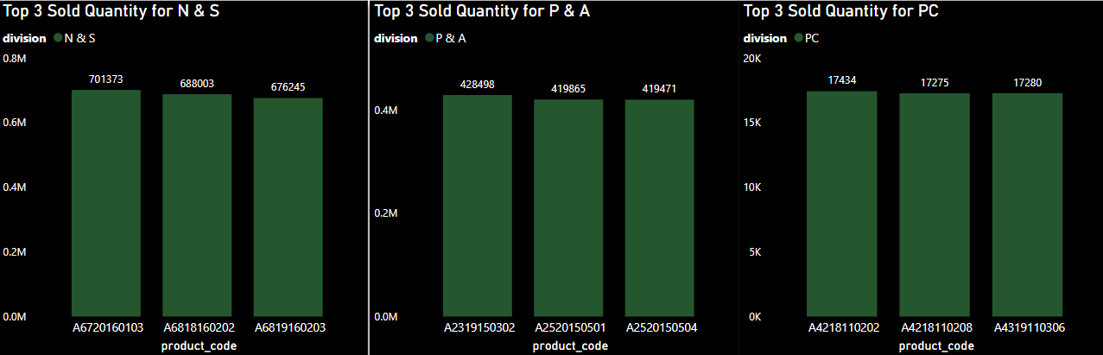
10. Get the Top 3 products in each division that have a high total sold quantity in the fiscal year 2021? The final output contains these fields, division product code codebasics.io product total sold quantity rank order

Slide 17
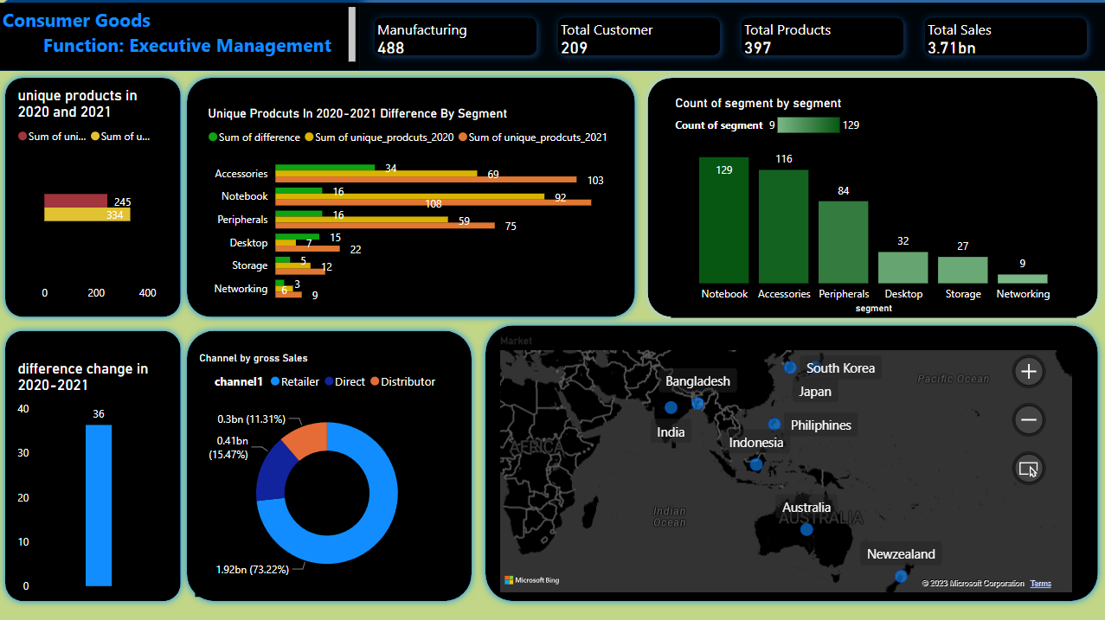
Notes:
Overview

Slide 18
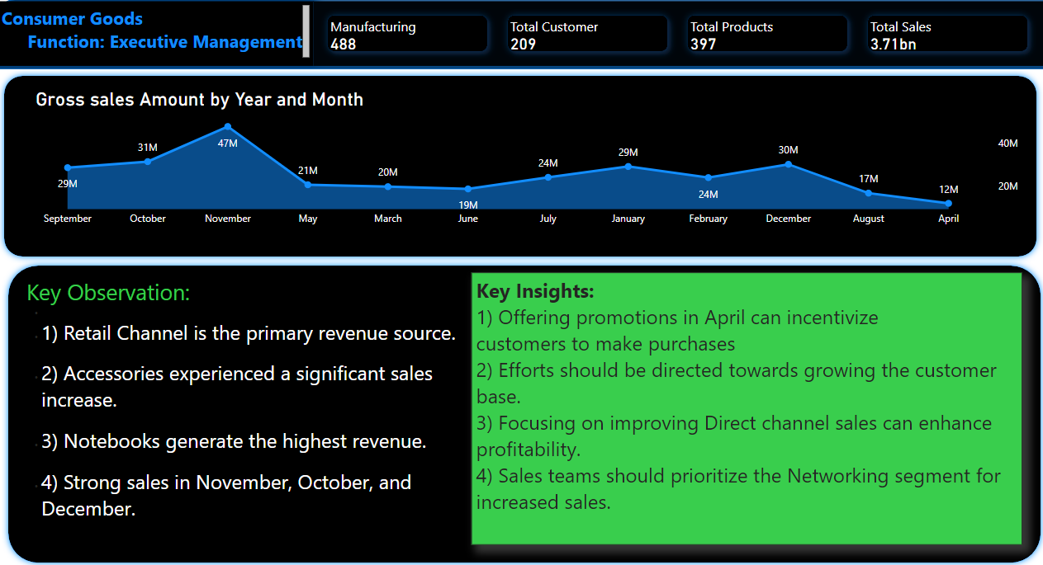
Notes:
Overview Continue

Slide 19

Thank you
From Basamma Madival

